Slide 1
IOTA Community Logo
IOTA
The distributed communication layer of tomorrow

Slide 2


DISCLAIMER:
NO FINANCIAL ADVICE WILL BE GIVEN IN THIS PRESENTATION

Slide 3
Index
whoami/whoarewe
The Tangle
IOTA
The IOTA Foundation
Use Cases
What today is about

Slide 4
Index
whoami/whoarewe
The Tangle
IOTA
The IOTA Foundation
Use Cases
What today is about

Slide 5


whoami/whoarewe
Name Surname
Your Title - yourwebsite.com
Following distributed ledger technology since 2011
Love Free and Open Source Software
Project with local company
Notes:
Present the organizers, speakers, supporters
Examples:
Your title, your line of work
what you do
when you started following IOTA

Slide 6
whoami/whoarewe
Name Surname
Your Title - yourwebsite.com
Following distributed ledger technology since 2011
Love Free and Open Source Software
Project with local company
Notes:
Present the organizers, speakers, supporters
Examples:
Your title, your line of work
what you do
when you started following IOTA

Slide 7
whoami/whoarewe
Name Surname
Your Title - yourwebsite.com
Following distributed ledger technology since 2011
Love Free and Open Source Software
Project with local company
Notes:
Present the organizers, speakers, supporters
Examples:
Your title, your line of work
what you do
when you started following IOTA

Slide 8




Technology
Governance
Ecosystem
Notes:
Important Puzzle Pieces
The Tangle and IOTA technology
The Governance by the IOTA Foundation
The Ecosystem around IOTA

Slide 9
What is a Distributed Ledger Technology?
Database of append only information
Peer to Peer Network
Each participant processes & verifies
Network reaches consensus

Slide 10



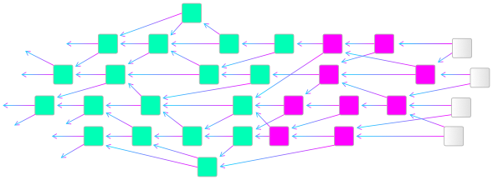
Blockchain vs. Tangle
Blockchain
Tangle
(DAG / Directed Acyclic Graph)
Notes:
As far as data structures go, Blockchains can be thought of as simple linked lists. Each entry on Bitcoin or Ethereum (or other networks) is put on top of the previous one to which it holds a reference. That’s how we get a linear sequence of digital events that we call a chain.
A DAG operates differently. This data structure resembles a flow chart where all points are headed in one direction. You can compare a Directed Acyclic Graph (DAG) to a file directory structure where folders have subfolders that branch into other subfolders and so on; they are tree-like. The word acyclic just means that no node in the graph can reference back to itself; it can’t be its own mother node.

Slide 11
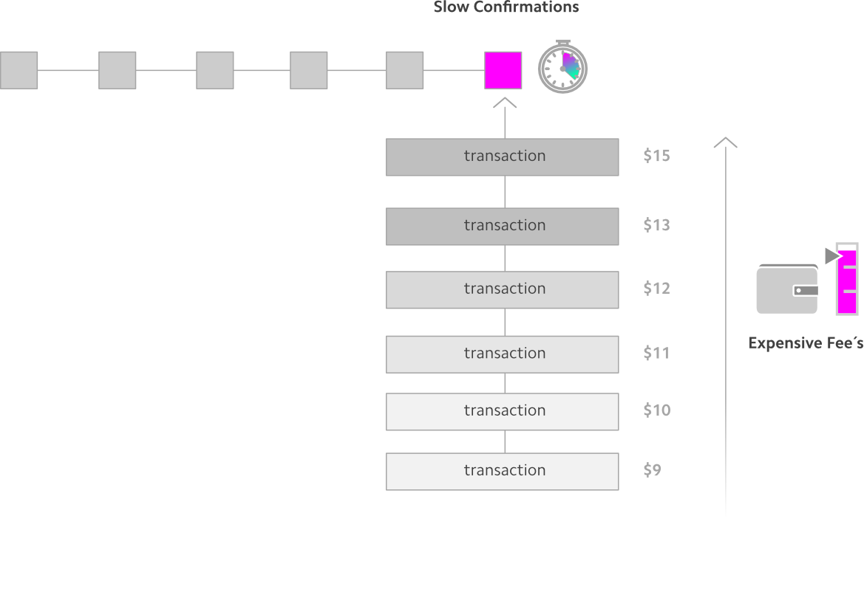
The Blockchain Bottleneck
Notes:
There are currently different roles for Bitcoin and Ethereum users; some submit transactions and others approve them. The fees are essential to such heterogeneous system as there’s always a need to incentivize validators to write to a blockchain’s history and secure the network.

Slide 12
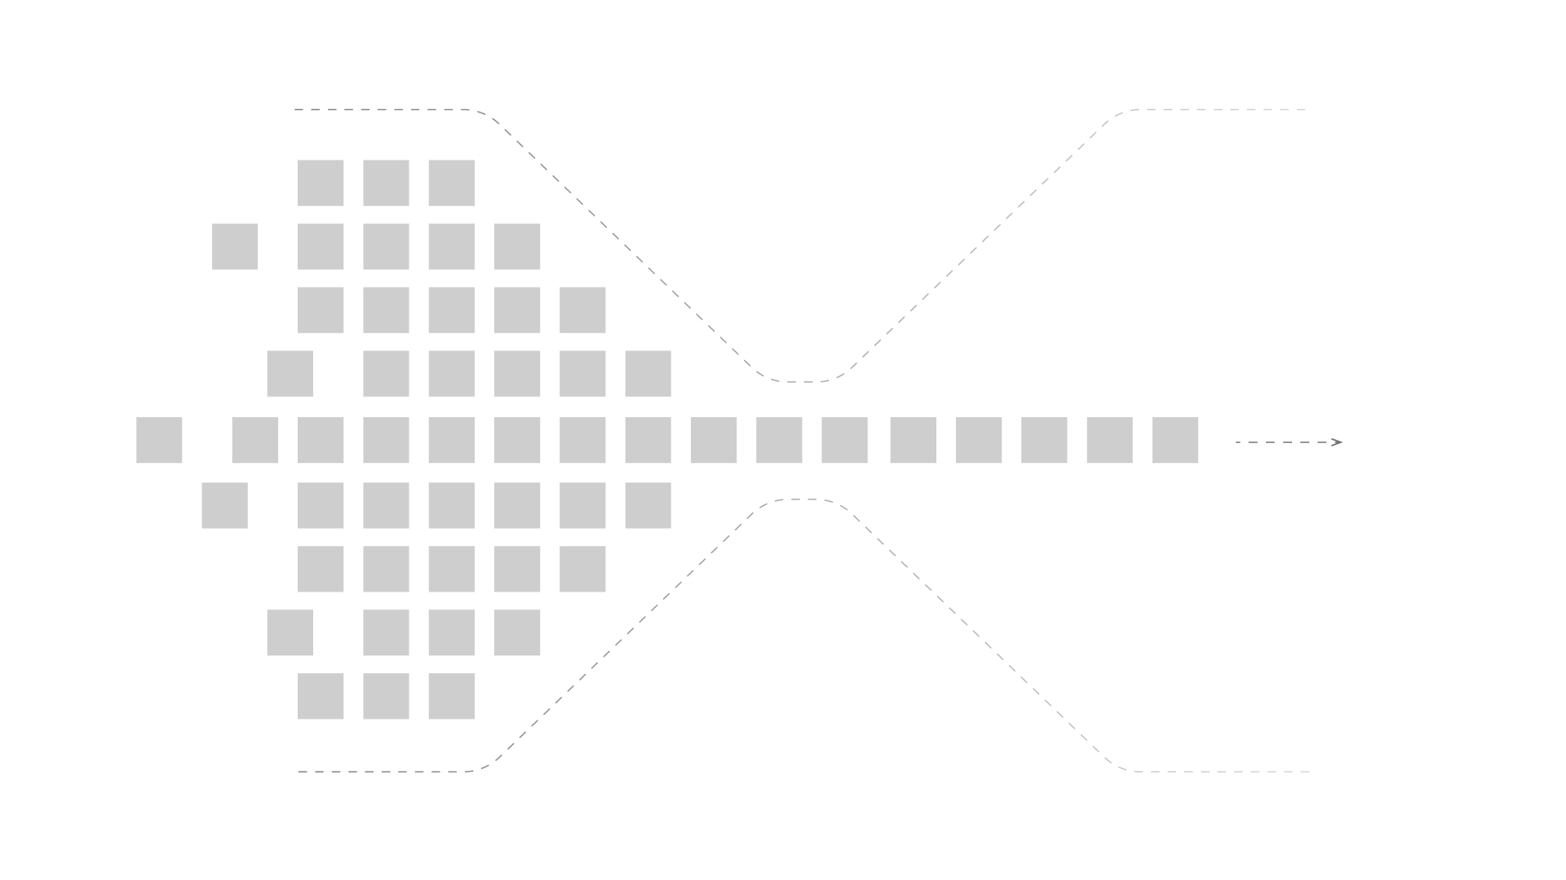
The Blockchain Bottleneck
Classic Bottleneck
Notes:
Blockchains allow one to track down any record stored in a ledger’s history, but their sequential structure is also what hinders significantly their transaction throughput; the flat list nature of blockchains is the biggest bottleneck for their ability to scale.

Slide 13

The Tangle
The Tangle is the immutable data structure that contains a history of IOTA transactions.
Notes:
This removes completely the need to pay fees to miners and thus opens up the possibility to execute microtransactions which could be worth as little as a few cents.
Besides, IOTA’s DAG data structure allows for the network’s easy scalability. Everyone is participating in reaching a consensus and, therefore, the more people are using IOTA, the faster the network becomes.

Slide 14

The Tangle
The unique data structure being utilized in IOTA
Directed Acyclic Graph (DAG)
Scalable distributed framework for transactions
Transactions can hold data, value or both
Consensus
Notes:
DAG - The references among transactions form a type of directed acyclic graph (DAG), which is a sequence of vertices where every edge is directed from an earlier point to a later one in the sequence (the animation shows the three dimensional version)
Scalability - When a node attaches a new transaction to the Tangle, that transaction directly references two existing ones (make a simple multiplication to show how numbers grow)
Consensus - Network nodes are responsible for validating transactions and their histories to make sure that they don't conflict.
When a node has a transaction's entire history, the transaction is considered solid, which means that it can be considered for confirmation.
Resources for the speaker:
https://docs.iota.org/docs/dev-essentials/0.1/concepts/the-tangle

Slide 15
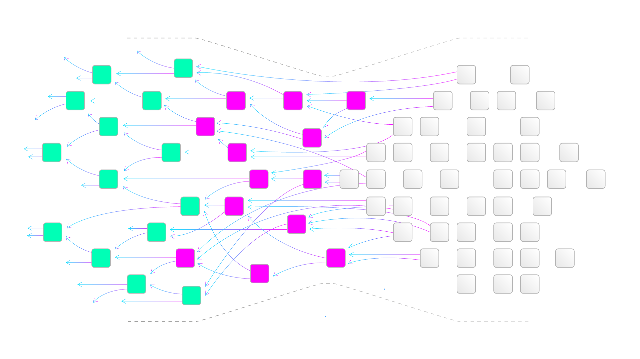
Tangle scales!
More activity
=
More validation
Notes:
Using DAG (which IOTA calls the Tangle), IOTA is able to assign the same exact duties to its every member; all the users on the network are both issues and transaction validators at the same time.
To have a transaction verified by IOTA, one has to approve two previous transactions (and ensure they’re not conflicting). Also, one needs to attach a tiny amount of proof of work as low difficulty computations are needed to prevent spam on the network.

Slide 16
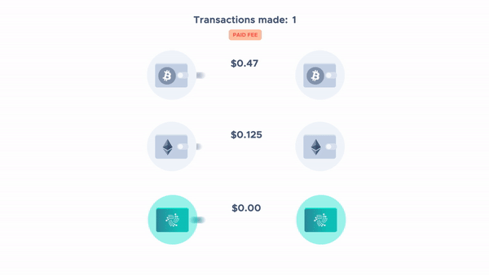
Tangle feeless!

Slide 17
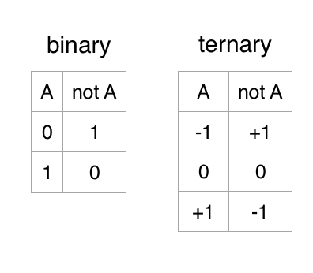


The IOTA Tangle - Ternary
Why Ternary?
Ternary is faster, more energy efficient and it also takes up less space
Ternary is very important for AI and NeuralNetworks
The ternary cryptographic environment can offer the following protections:
  Malware
  Breaches in access control will be reduced with the ternary PKD with the one-time public/private key pair
  Eavesdropping problems will be greatly reduced because all aspects of the ternary architecture can change constantly
Notes:
Institute of Electrical and Electronics Engineers
Continuously changing sets of ternary instructions on each machine, based on public key exchanges, are expected to make conversions between binary and ternary non-trivial;
The use of multi-factor authentication with subject–object pairing and passwords is suggested;
Ternary neural networks for resource-efficient AI applications
https://ieeexplore.ieee.org/document/7966166
Can Ternary Computing Improve Information Assurance?
https://www.mdpi.com/2410-387X/2/1/6/htm

Slide 18
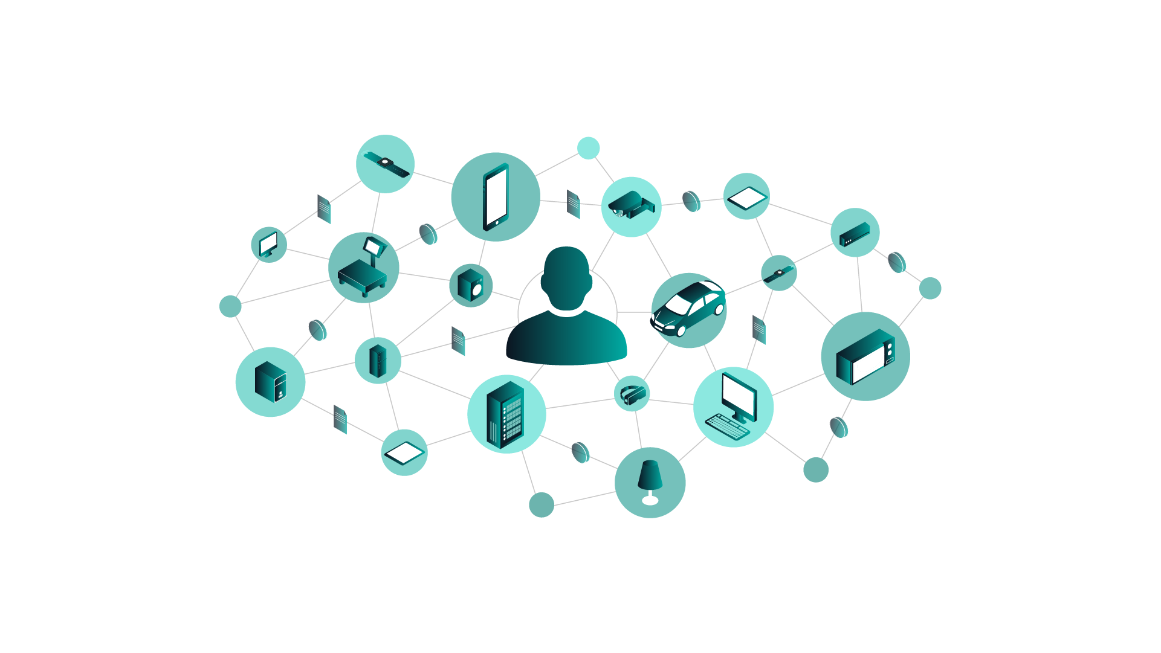
Introduction to the IOTA protocol
IOTA is a distributed ledger technology that allows devices to transfer immutable data and value among each other

Slide 19
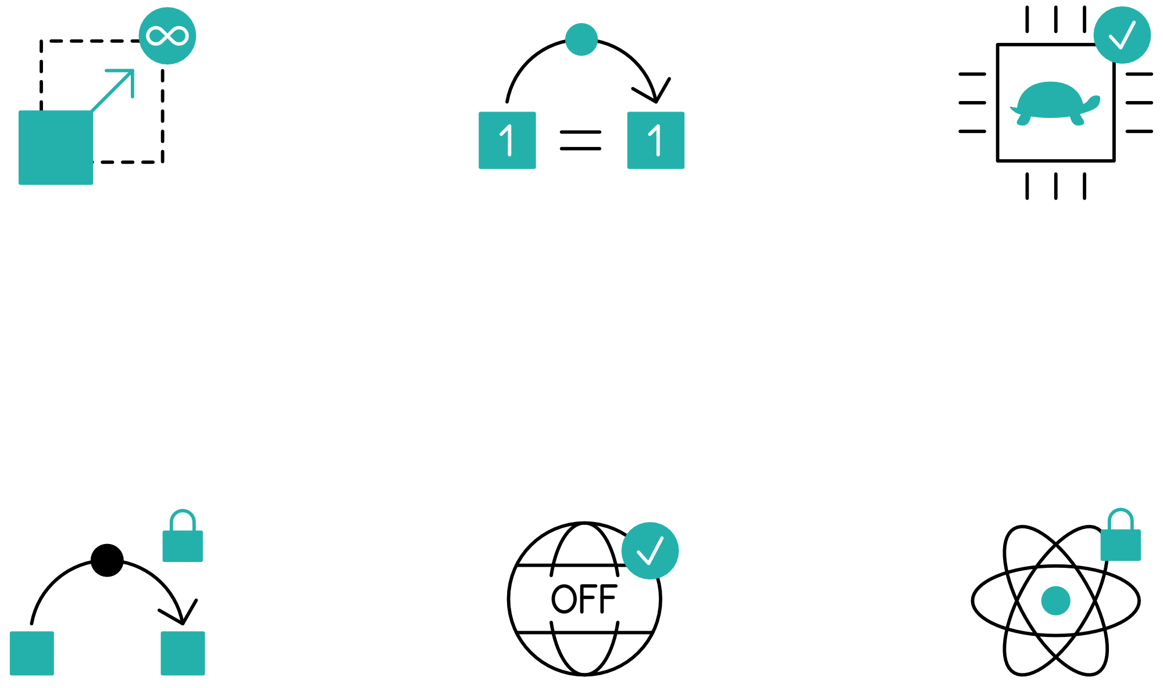
Introduction to the IOTA protocol
Highly scalable
Zero-fee transactions
Overcoming
the limitations of
Blockchain
Immutable
data transfer
Quantum robust
Notes:
IOTA is:
- permissionless, which means that anyone can use the network to make payments or send data. You don't need to sign up, give away your personal details, or pay a subscription.
- decentralized: no entity (e.g. government can take it down)
- transparent: how it works is transparent and the open source code can be audited anytime
- has tokens: the same layer that transports data can also transport value, therefore it is a starting point for the machine-2-machine economy
The cryptographic functions in the IOTA protocol allow you to benefit from the following:
Authenticity: Prove that you sent a transaction and that you own the data or IOTA tokens in it
Integrity: Prove that your transaction is unchanged
Confidentiality: Control who has access to your data through encryption
Resources for the speaker:
https://docs.iota.org/docs/getting-started/0.1/introduction/what-is-iota

Slide 20
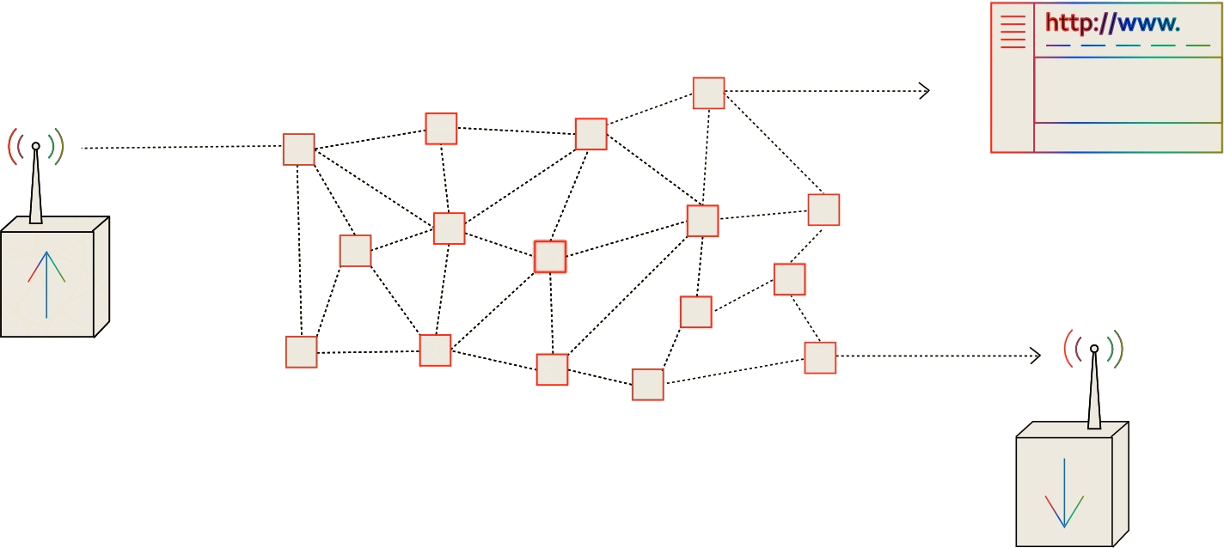
Masked Authenticated Messaging (MAM)
Notes:
Masked Authenticated Messaging (MAM) is a data communication protocol that allows you to publish encrypted data streams, called channels, in transactions on the Tangle.
In IOTA, a user can publish a message at any time. They only need to conduct a small amount of proof of work to allow the data to propagate through the network (This is necessary to prevent spamming of the network). If nodes are listening for the channel ID (= address) in real time, the message (gossipped through the network) will be received by a subscriber when it reaches the subscriber’s node.
Resources for the speaker:
https://docs.iota.org/docs/client-libraries/0.1/mam/introduction/overview
https://blog.iota.org/introducing-masked-authenticated-messaging-e55c1822d50e
https://www.youtube.com/watch?v=Nnwn_o_ZBFU

Slide 21
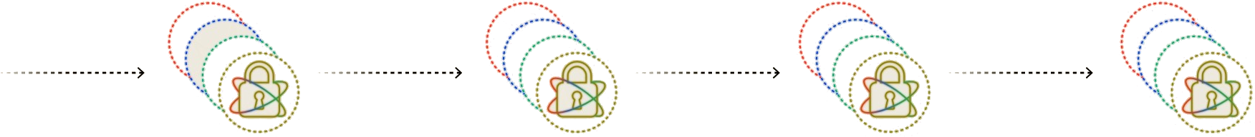
Masked Authenticated Messaging (MAM)
Notes:
Message payload is encrypted and signed
Encrypted Message is published to a data transaction
Each message points forward to a future ID
Channel types
You can publish messages to any of the following channel modes:
Public
Private
Restricted
Public channels
Public channels use the root as the address of the transaction that contains the MAM message (channel ID). As a result, anyone can decrypt messages in a public channel by using the address.
This mode could be used for public announcements or even a immutable social media application with built-in authentication.

Slide 22
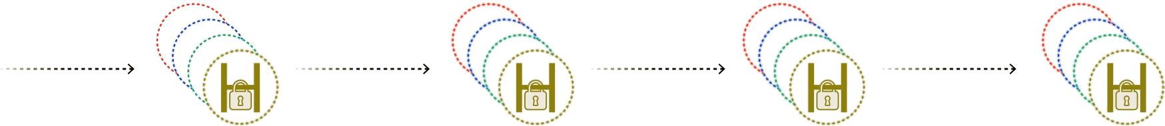
Masked Authenticated Messaging (MAM)
Notes:
Private channels
Private channels use the hash of the root as the address of the transaction that contains the MAM message (channel ID). As a result, only those with the original root can decrypt the messages in a private channel.
This mode is useful for devices that want to communicate in private among each other.

Slide 23
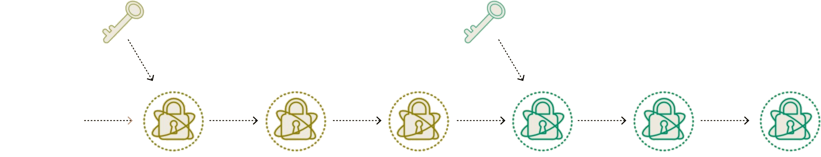
Masked Authenticated Messaging (MAM)
Notes:
Restricted channels
Restricted channels adds an authorization key, called the side key, to private mode. The address of the transaction that contains the MAM message (channel ID) is the hash of the side key and the root. As a result, only those with the original root and the side key can decrypt messages in a private channel.
This mode is useful for being able to revoke access to the channel by changing the side key. When you change a side key, you just need to distribute it to the parties that are allowed to follow the rest of the channel.

Slide 24
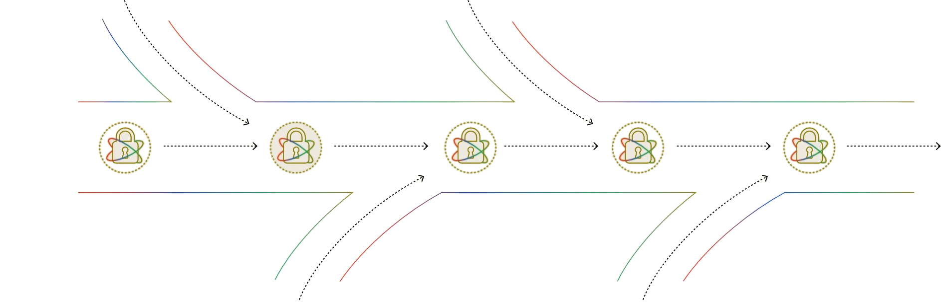
Masked Authenticated Messaging (MAM)
Notes:
Forward Secrecy
Since each message contains the root of the next merkle tree it is easy for users to follow the stream given once the current tree is exhausted if they also know the type of stream and the optional authorisation key being used. Given that a current message only points to the next merkle tree, there is no way for a user reading the MAM stream to read messages prior to the root they have been given. It’s easiest to think of a MAM stream as a freeway: when you first start to read a stream you are entering the freeway and you can’t go against the flow of traffic.

Slide 25
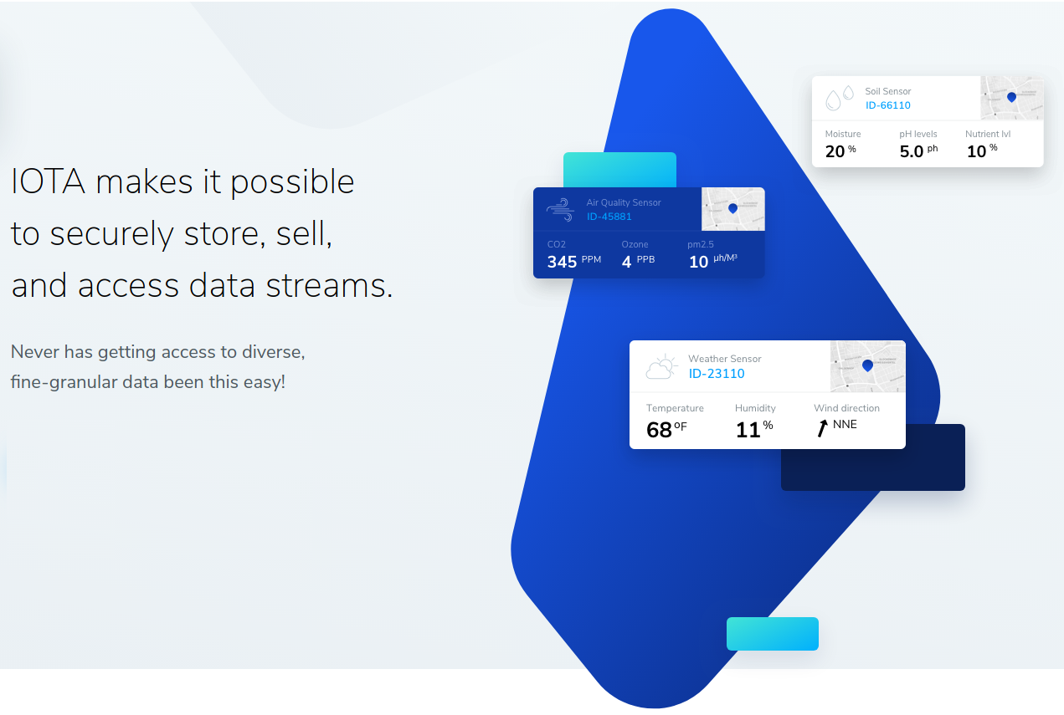
Decentralized Marketplace
Available as open source blueprint
Uses MAM channels to open up silos
Allow users to pay owners for their data through microtransactions
data.iota.org
Notes:
Data silos make it difficult to buy and sell data among different data points. To overcome this challenge, the Data Marketplace uses Masked Authenticated Messaging (MAM) channels to open up the data silos and allow users to make micropayments of IOTA tokens to the data owners in exchange for data.
Available as opensource App
https://docs.iota.org/docs/blueprints/0.1/data-marketplace/overview
Resources for the speaker:
https://docs.iota.org/docs/blueprints/0.1/data-marketplace/overview

Slide 26
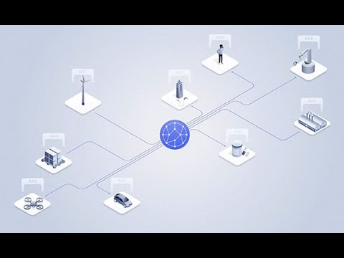
Decentralized Marketplace
https://youtu.be/Jnh_9nKkemM

Slide 27
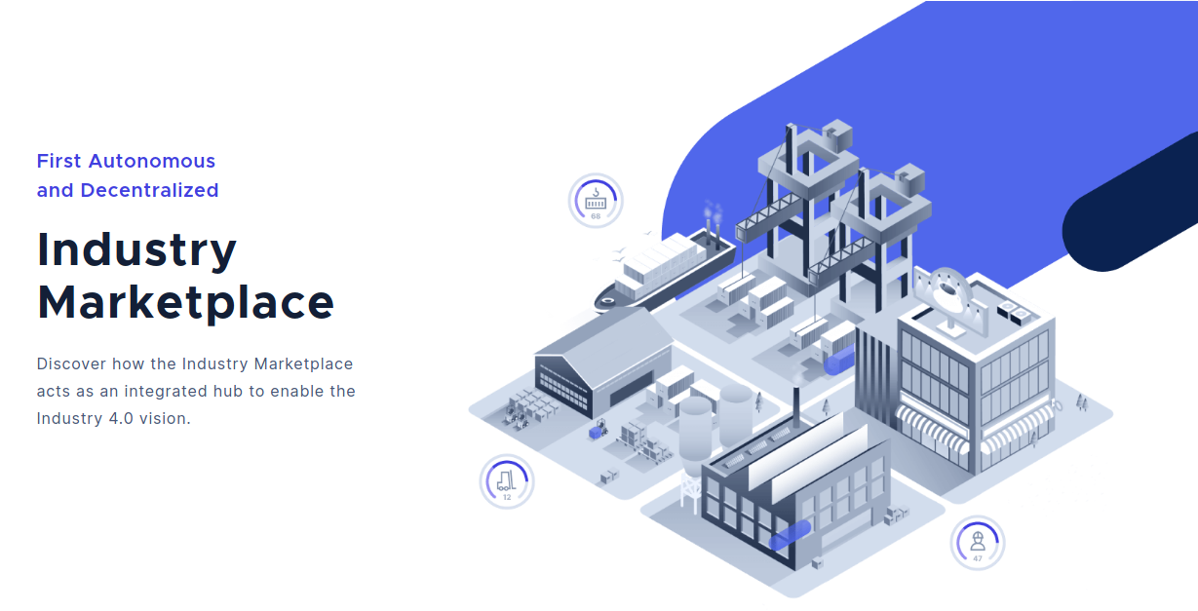



Decentralized Marketplace
Vendor Neutral
Machine Interaction
Semantic Language
Decentralized
Integrated ID
Integrated payment
industry.iota.org
Notes:
The Industry Marketplace is a vendor and industry-neutral platform, automating the trading of physical and digital goods and services.
Building on specifications developed by the Plattform Industrie 4.0 (Germany's central network for the advancement of digital transformation in manufacturing), it combines distributed ledger technology, immutable audit logs and standardized, machine-readable contracts to accelerate industrial automation and enable the "economy of things".
Resources for the speaker:
https://github.com/iotaledger/industry-marketplace/raw/master/Industry_Marketplace_Technical_Documentation.pdf

Slide 28


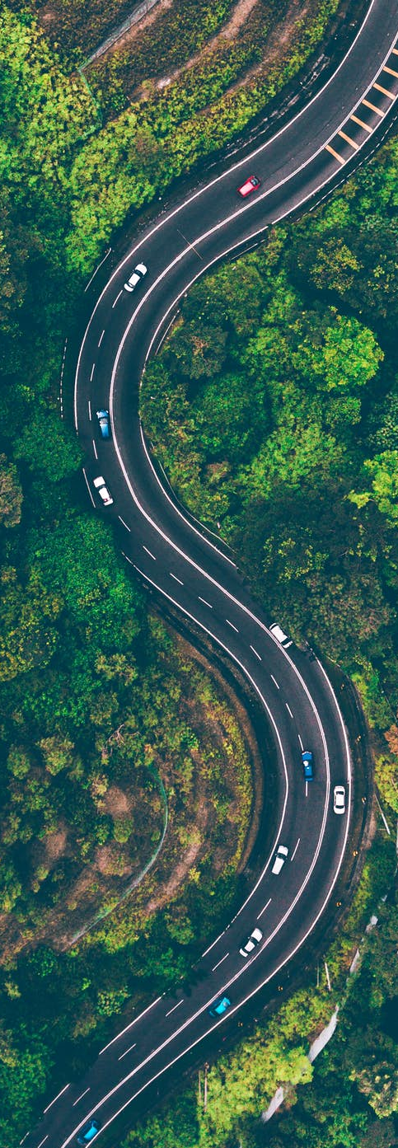


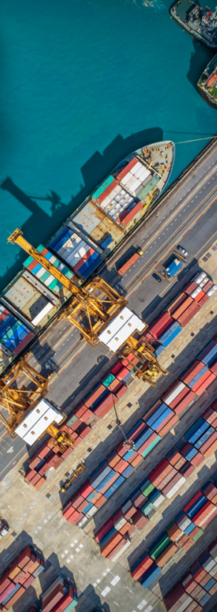
Use-Cases
Telecom
Mobility
Digital Economy
- Payments
- Settlement
- Data Sharing
- Data Integrity
- Identity Management
- Smart Charging
- Over-the-Air Updates
- Car ID & Wallet
- Cars as Autonomous
Economic Agents
- Usage Based Insurance
- Car Paying for Parking
- M2M Economy
- MyData & GDPR
- Biometric Authentication
& Digital ID
- IOTA Data Marketplace
- Smart Factory
- Digital Twin
Smart City
Supply Chain
Social Impact
- Digital ID
- Smart Energy Districts
- P2P Energy Grid
- Cross vertical
- Biometric Identification
- CityxChange Smart
Cities
- Asset Tracking
- Connected Supply Chains
- Global Trade Document Flow
- Product Authenticity and
Provenance
- Ports Management
- New Insurance Models
- Digital ID & Citizen Services
- Humanitarian ID
- Real-time Environmental
Monitoring
- Financial Inclusion
Notes:
Resources for speaker:
https://files.iota.org/comms/IOTA_Use_Cases.pdf

Slide 29

The IOTA Foundation
The IOTA Foundation - to research, develop and grow market adoption of DLT
Non-profit Foundation based and regulated in Berlin, Germany
Growth from 6 to 100+ full time employees distributed across 27 countries
Focused on technical and regulatory challenges of crypto-currencies & DLT
Notes:
Make sure to emphasize that IF's goal is to be irrelevant in 5 years. One of many actors guiding, building, using the Tangle

Slide 30

IOTA Foundation - Vision & Goals

Slide 31

IOTA Ecosystem
Our universe relies on a network of many collaborators
– corporates, academics, governments, NGOs
Notes:
Sources for official Ecosystem
https://blog.iota.org
https://ecosystem.iota.org
Sources for unofficial Ecosystem:
https://iota-archive.com/

Slide 32

IOTA Ecosystem
Meet the IOTA Ecosystem
Tutorials
Projects
Events
Developers
Notes:
The IOTA Ecosystem is a hub of education, innovation, tools, collaboration and development for the IOTA distributed ledger protocol and is lead by the IOTA Foundation.
The Ecosystem also is responsible for the Ecosystem Development Fund.
Resources for speaker:
https://ecosystem.iota.org

Slide 33

IOTA Ecosystem Development Fund
Funding for projects in the IOTA Ecosystem
Proof of concepts
Open source utilities and libraries
Educational resources
Media
Philanthropic endeavors
Hackathons
Ideation workshops
Meetups
Notes:
Ecosystem Development Fund Is a collection of donations that are granted to IOTA related projects
Is committed to Transparency, accountability and by memorializing EDF funding agreements with ‘Proof-of-Existence’ transactions on the Tangle, anyone will be able to verify that agreements the EDF enters existed in a certain state at a certain point in time. The IOTA community can thus hold both the EDF and the benefactors of EDF
Resources for speaker:
https://fund.iota.org

Slide 34

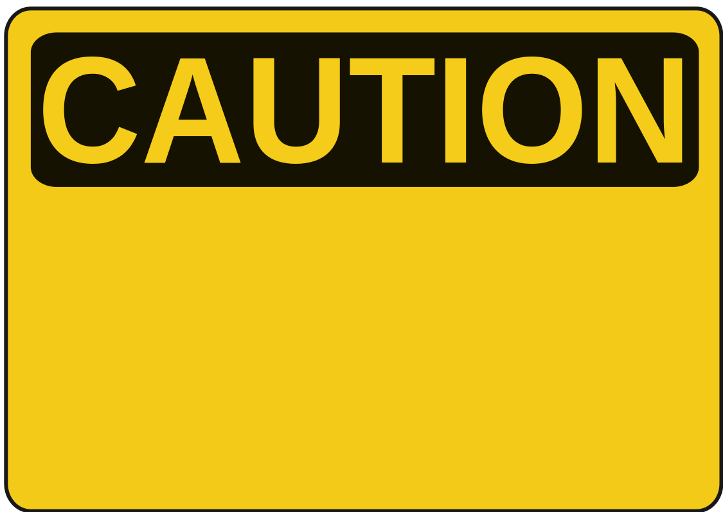
Mobility & Automotive - PoC by bIOTAsphere
Insuremycar PoC
Dynamic insurance provider
Direct payments
Vehicle monitoring
Proof-of-Concept
NOT endorsed by Tesla
Notes:
Resources for speaker:
https://youtu.be/6VYQYlzNPFs

Slide 35

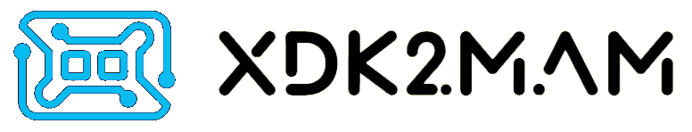
IIoT/IoT - Bosch XDK
Fast and easy IOTA integration for prototypes
Secure and immutable sensor data transmission via IOTA
Micropayments on the (Industrial) Data Marketplace
Bosch XDK110 and
Masked Authentication Messaging
Notes:
Resources for the speaker:
XDK2MAM: https://xdk2mam.io
Data marketplace open source blueprint: https://docs.iota.org/docs/blueprints/0.1/data-marketplace/overview
Industry Marketplace https://industry.iota.org/

Slide 36
Contacts:
Sponsors:
Get involved:
email@provider.com
website.com
twitter.com/myhandle
linkedin.com/in/mylink
<SPONSOR NAME>
<Description>
sponsor.website.com
Website:
Ecosystem:
Discord:
Twitter:
LinkedIn:
YouTube:
www.iota.org
ecosystem.iota.org
discord.iota.org
twitter.com/iotatoken
linkedin.com/company/iotafoundation
www.youtube.com/c/iotafoundation

